Slide 1



Google Cloud Platform
Acompañamiento
GCP – Google BigQuery
Noviembre de 2023
Notes:
1

Slide 2
AGENDA
BigQuery Architecture (MPP)
Slots → Ondemand Pricing / Flat Rate Pricing
OLAP vs OLTP
Table sharding / Data Expiration
Load Data to BQ (Data Formats)
ELT vs ETL
TEMP TABLE vs WITH clauses
Join Patters and Broadcasting
String functions / Approximate functions / Array functions
Cloud Monitoring and BQ Administrative Resource Charts
BQ Bi Engine
Notes:
2

Slide 3
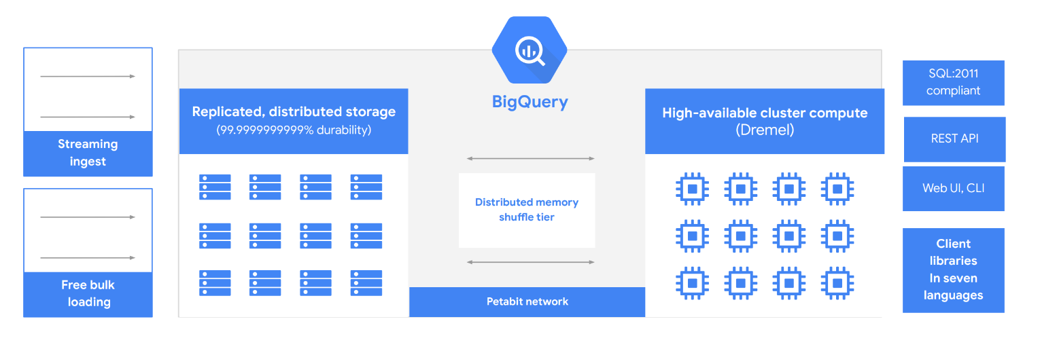
BigQuery Architecture
Notes:
Data Lake:
https://cloud.google.com/learn/what-is-a-data-lake
Google Cloud Storage:
https://cloud.google.com/storage?hl=en
Big Query:
https://cloud.google.com/bigquery?hl=en
Dataflow:
https://cloud.google.com/dataflow?hl=en
Dataproc:
https://cloud.google.com/dataproc?hl=en
Cloud Data Fusion:
https://cloud.google.com/data-fusion?hl=en
Transfer services:
https://cloud.google.com/storage-transfer/docs/overview
Transfer appliance
https://cloud.google.com/transfer-appliance/docs/4.0/specifications
Data Fusion:
Diseño con un núcleo de código abierto (CDAP) para facilitar la portabilidad de flujos de procesamiento
https://github.com/priyankavergadia/google-cloud-4-words
3

Slide 4
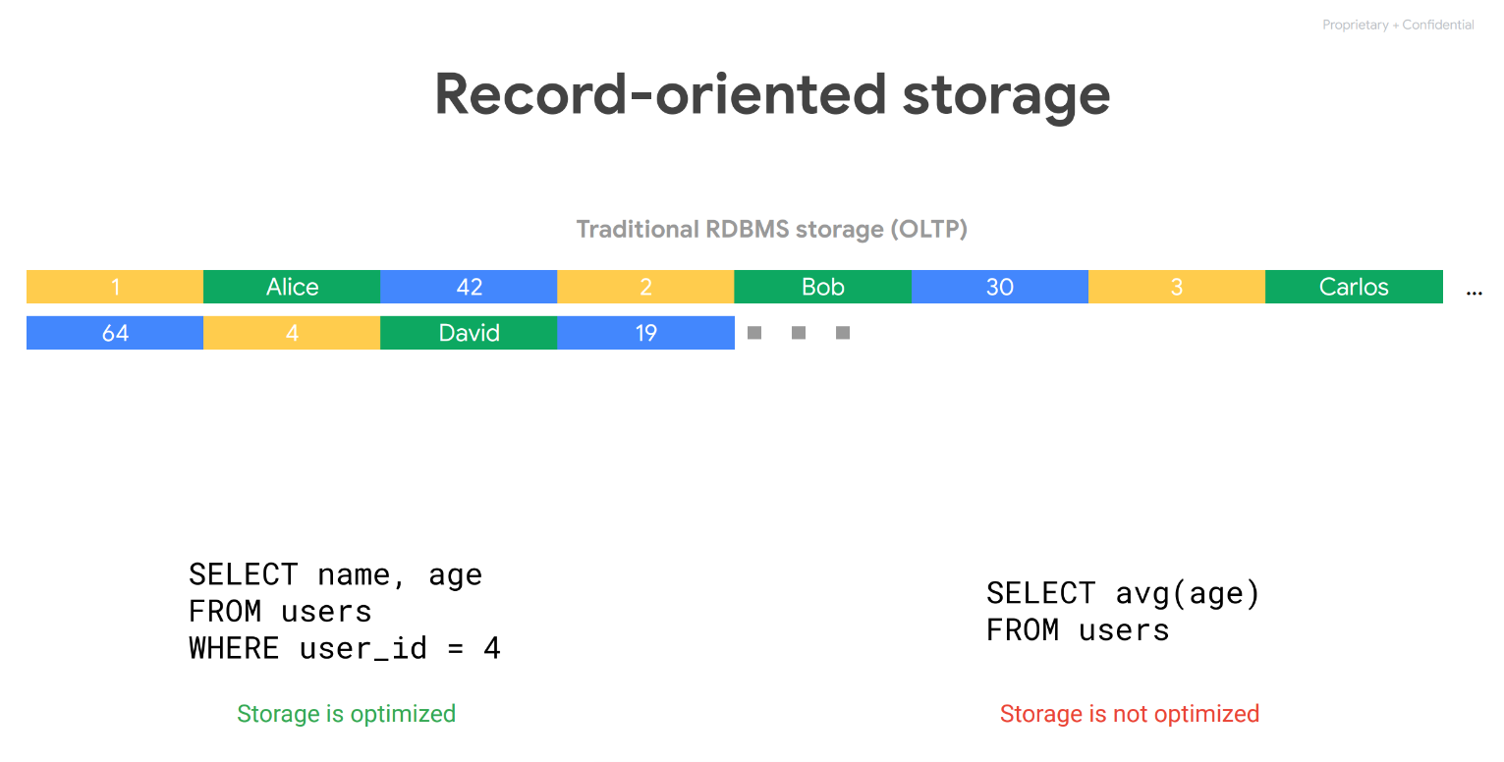
Notes:
4

Slide 5
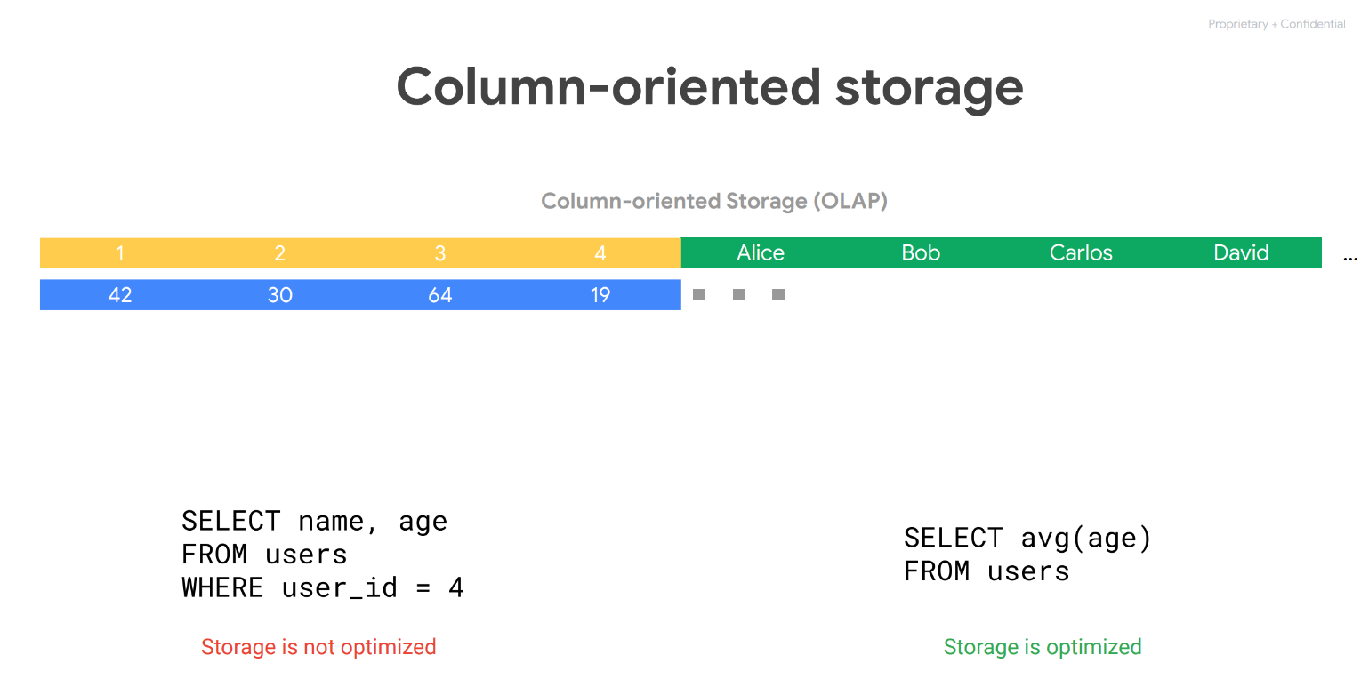
Notes:
5

Slide 6
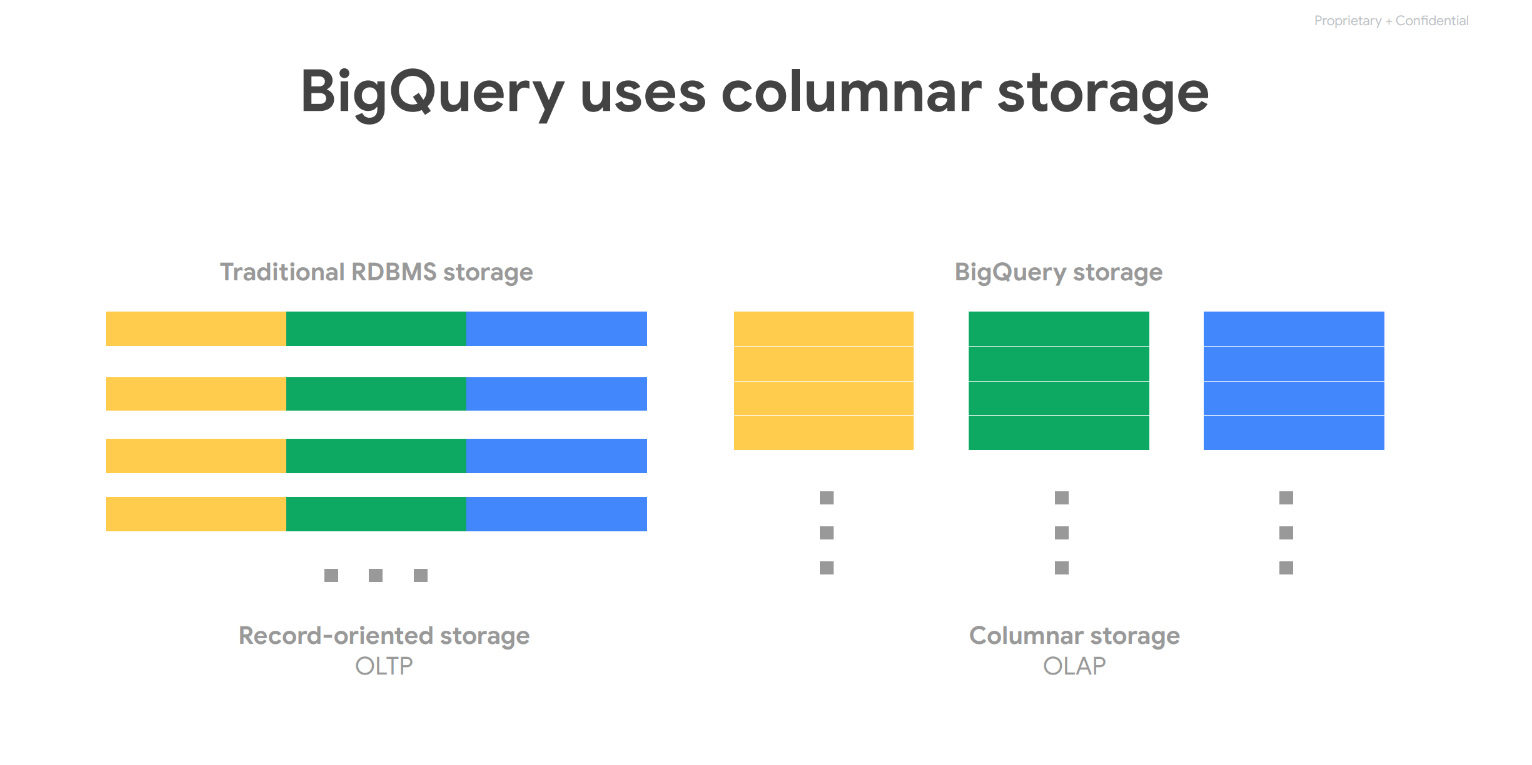
Notes:
6

Slide 7
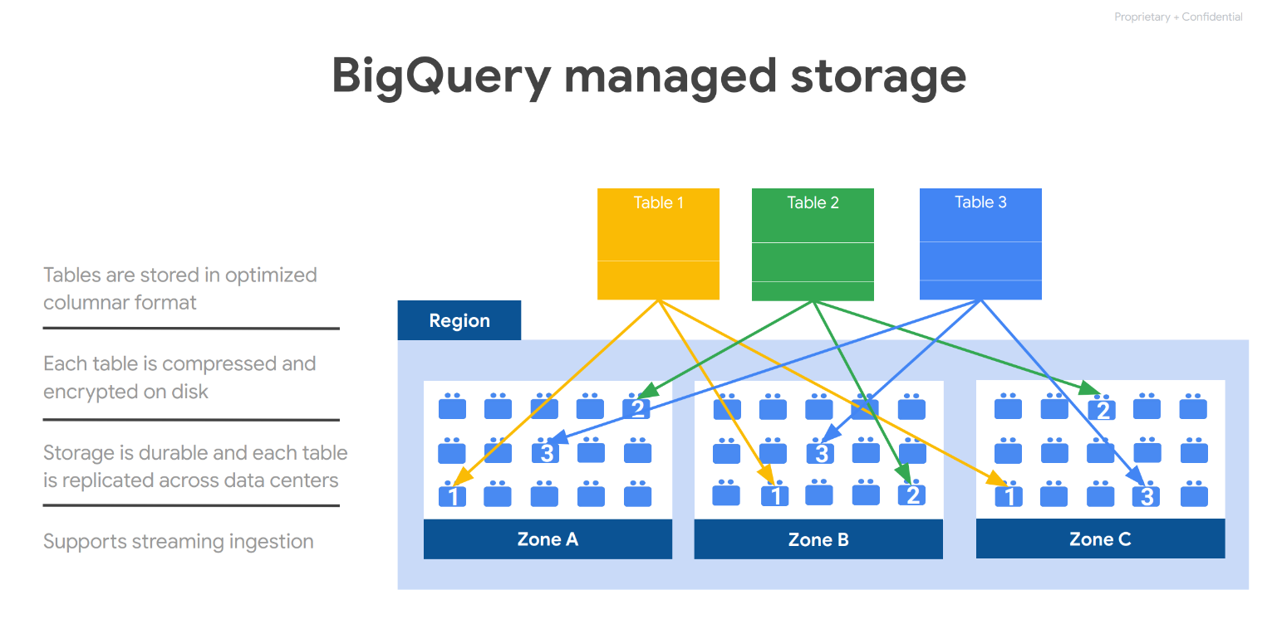
Notes:
7

Slide 8
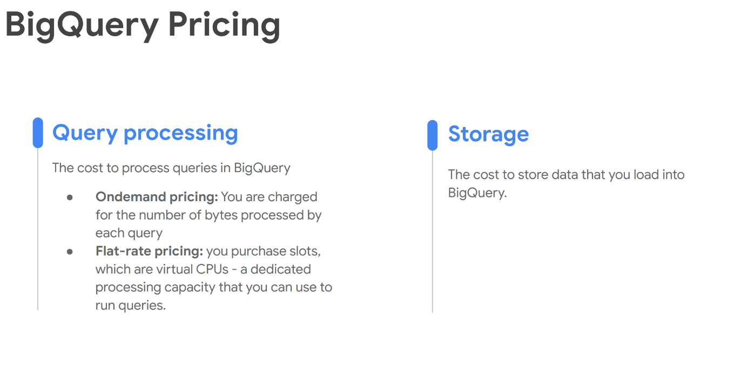
Notes:
Data Lake:
https://cloud.google.com/learn/what-is-a-data-lake
Google Cloud Storage:
https://cloud.google.com/storage?hl=en
Big Query:
https://cloud.google.com/bigquery?hl=en
Dataflow:
https://cloud.google.com/dataflow?hl=en
Dataproc:
https://cloud.google.com/dataproc?hl=en
Cloud Data Fusion:
https://cloud.google.com/data-fusion?hl=en
Transfer services:
https://cloud.google.com/storage-transfer/docs/overview
Transfer appliance
https://cloud.google.com/transfer-appliance/docs/4.0/specifications
Dataplex:
Centralized security and governance enabling distributed ownership of data with global control
Vertex AI:
https://cloud.google.com/vertex-ai?hl=en
https://cloud.google.com/vertex-ai/docs/general/locations
https://github.com/priyankavergadia/google-cloud-4-words
https://googlecloudcheatsheet.withgoogle.com/
https://github.com/priyankavergadia/google-cloud-4-words
8

Slide 9
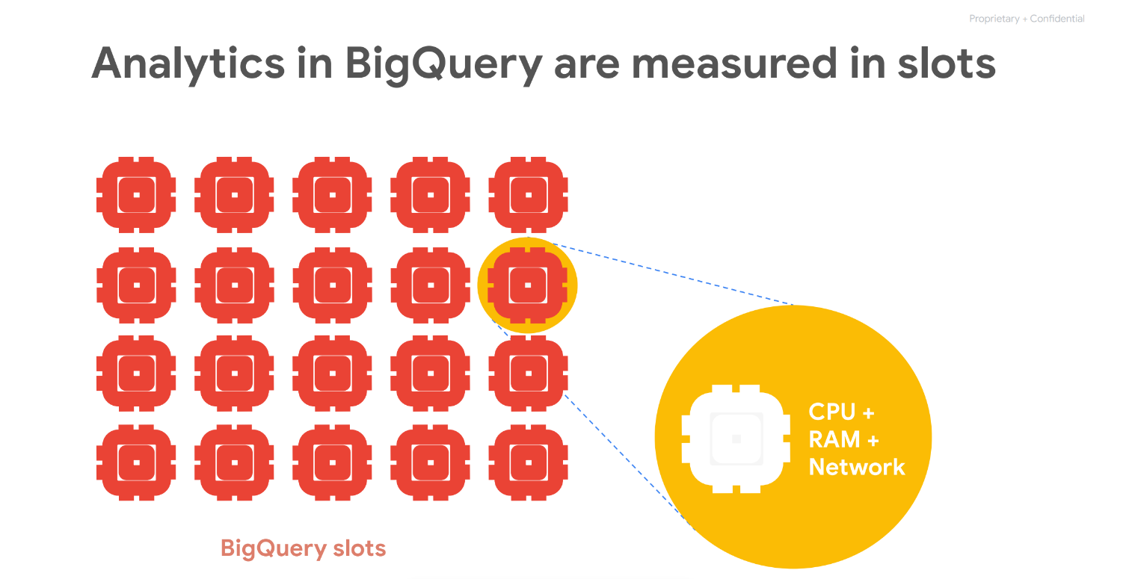
Notes:
Data Lake:
https://cloud.google.com/learn/what-is-a-data-lake
Google Cloud Storage:
https://cloud.google.com/storage?hl=en
Big Query:
https://cloud.google.com/bigquery?hl=en
Dataflow:
https://cloud.google.com/dataflow?hl=en
Dataproc:
https://cloud.google.com/dataproc?hl=en
Cloud Data Fusion:
https://cloud.google.com/data-fusion?hl=en
Transfer services:
https://cloud.google.com/storage-transfer/docs/overview
Transfer appliance
https://cloud.google.com/transfer-appliance/docs/4.0/specifications
Dataplex:
Centralized security and governance enabling distributed ownership of data with global control
Vertex AI:
https://cloud.google.com/vertex-ai?hl=en
https://cloud.google.com/vertex-ai/docs/general/locations
https://github.com/priyankavergadia/google-cloud-4-words
https://googlecloudcheatsheet.withgoogle.com/
https://github.com/priyankavergadia/google-cloud-4-words
9

Slide 10
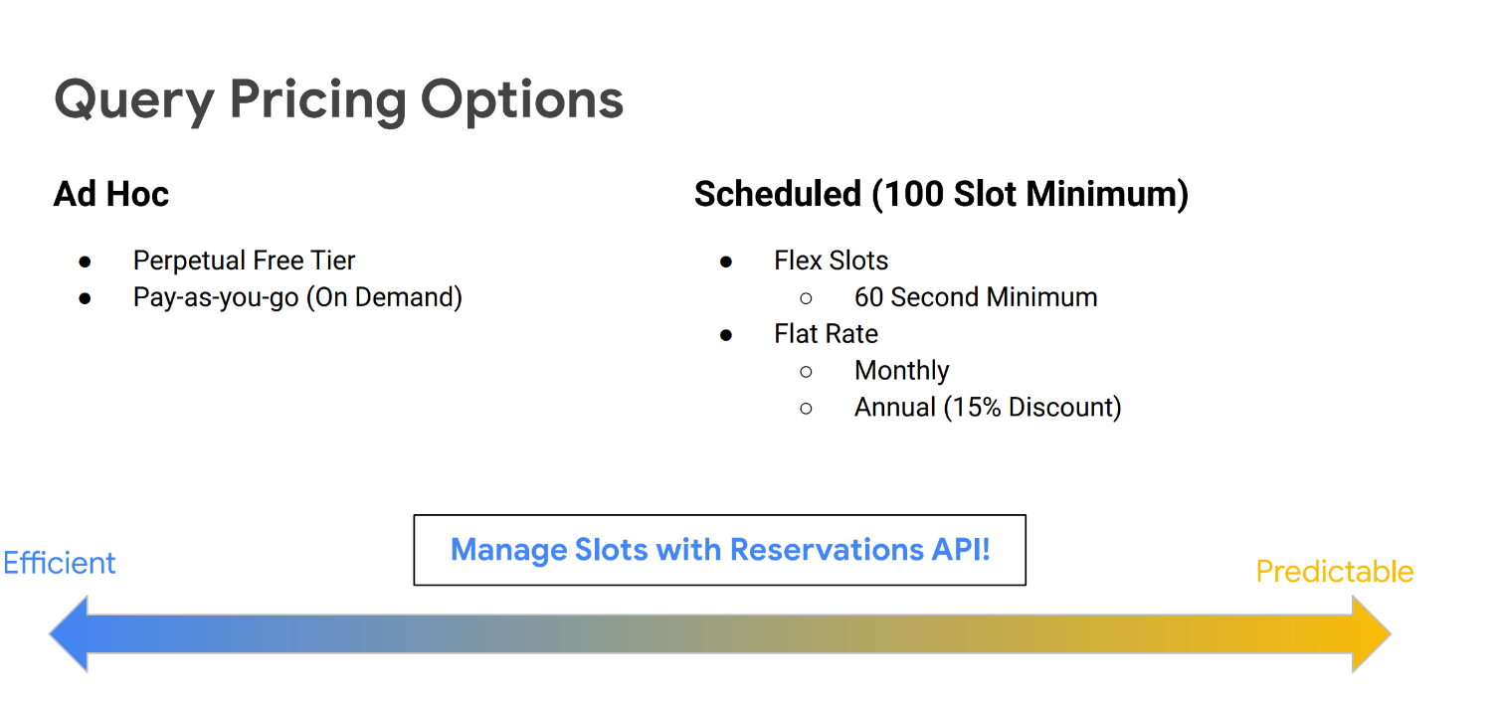
Notes:
A data lake provides a scalable and secure platform that allows enterprises to: ingest any data from any system at any speed—even if the data comes from on-premises, cloud, or edge-computing systems; store any type or volume of data in full fidelity; process data in real time or batch mode; and analyze data using SQL, Python, R, or any other language, third-party data, or analytics application.
Data Lake:
https://cloud.google.com/learn/what-is-a-data-lake
10

Slide 11
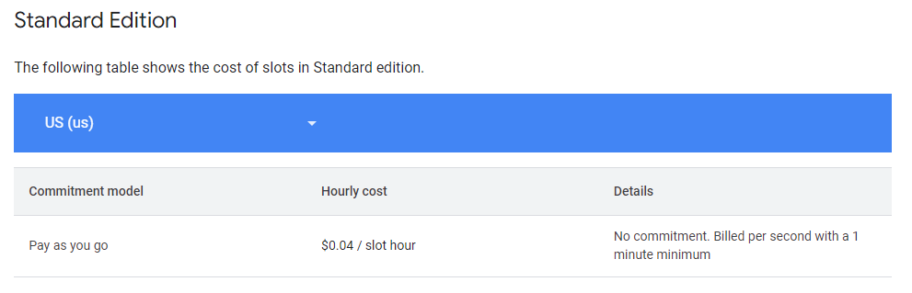
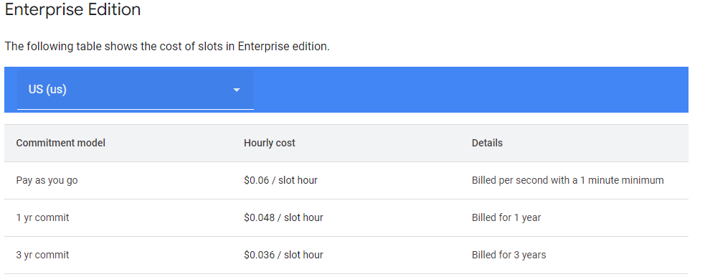
BigQuery Pricing Details
Notes:
11

Slide 12
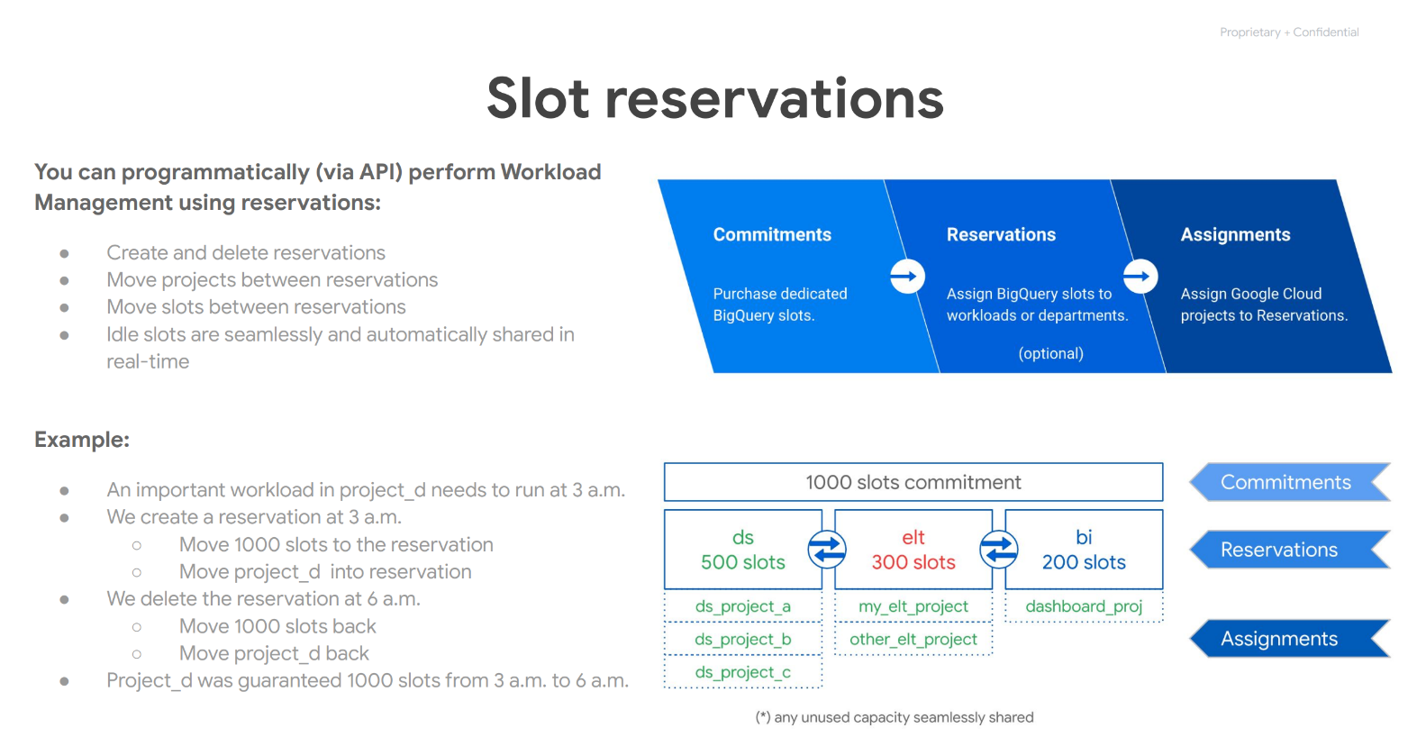
Notes:
Data Lake:
https://cloud.google.com/learn/what-is-a-data-lake
Google Cloud Storage:
https://cloud.google.com/storage?hl=en
Big Query:
https://cloud.google.com/bigquery?hl=en
Dataflow:
https://cloud.google.com/dataflow?hl=en
Dataproc:
https://cloud.google.com/dataproc?hl=en
Cloud Data Fusion:
https://cloud.google.com/data-fusion?hl=en
Transfer services:
https://cloud.google.com/storage-transfer/docs/overview
Transfer appliance
https://cloud.google.com/transfer-appliance/docs/4.0/specifications
Dataplex:
Centralized security and governance enabling distributed ownership of data with global control
Vertex AI:
https://cloud.google.com/vertex-ai?hl=en
https://cloud.google.com/vertex-ai/docs/general/locations
https://github.com/priyankavergadia/google-cloud-4-words
https://googlecloudcheatsheet.withgoogle.com/
https://github.com/priyankavergadia/google-cloud-4-words
12

Slide 13
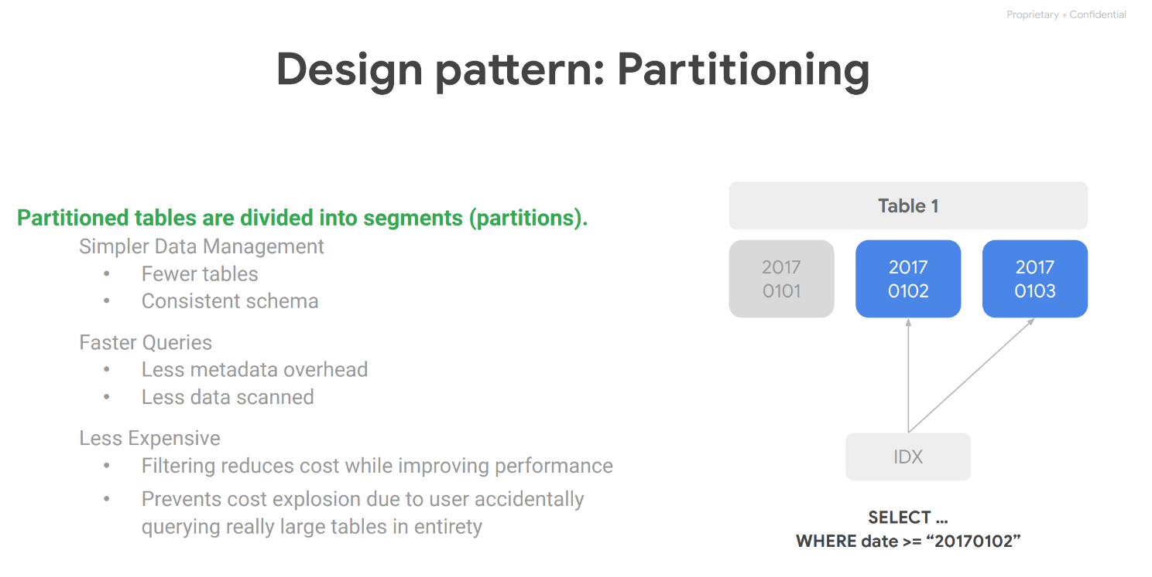
Notes:
13

Slide 14
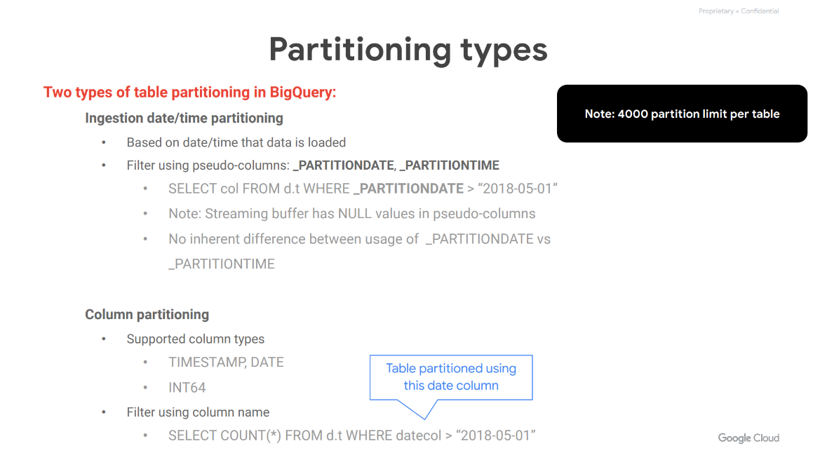
Notes:
14

Slide 15
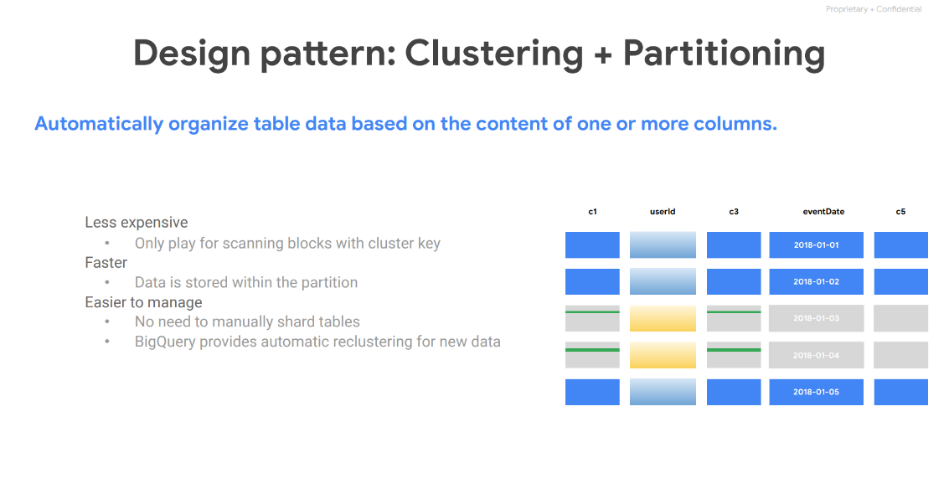
Notes:
15

Slide 16
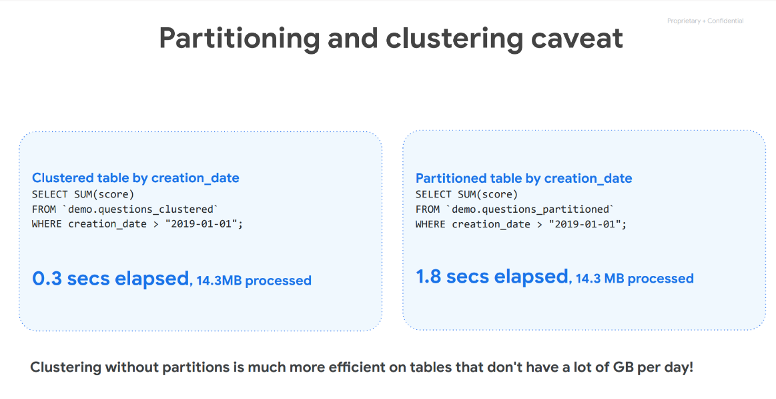
Notes:
16

Slide 17
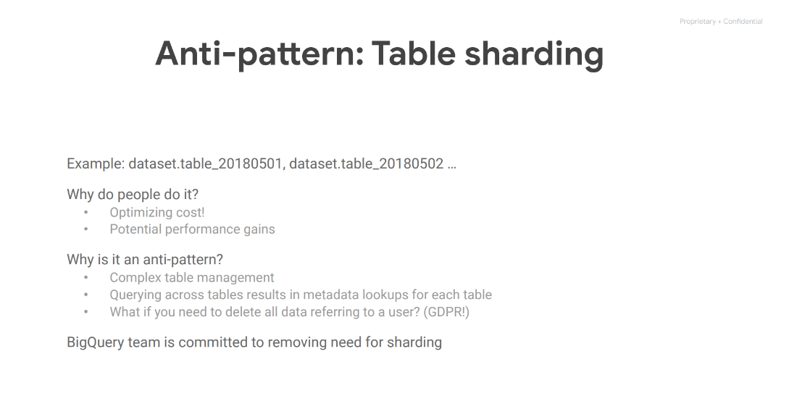
Notes:
17

Slide 18
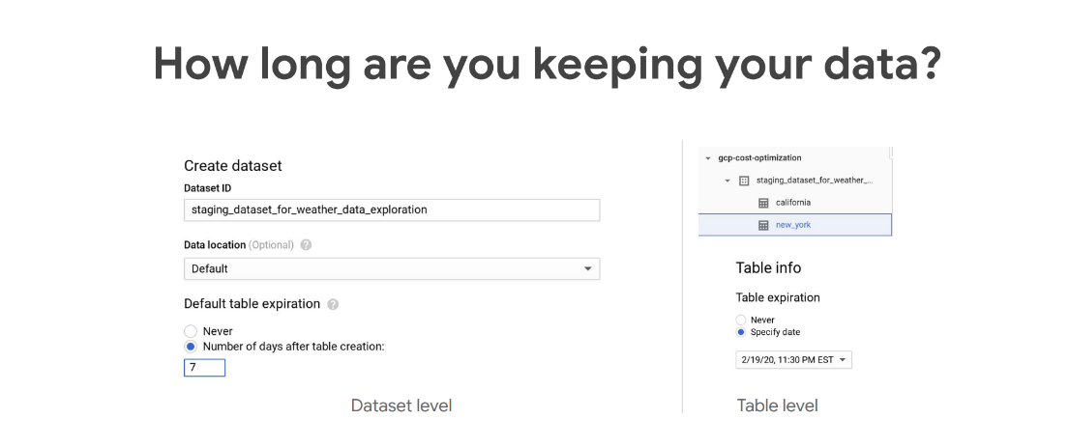
Notes:
18

Slide 19
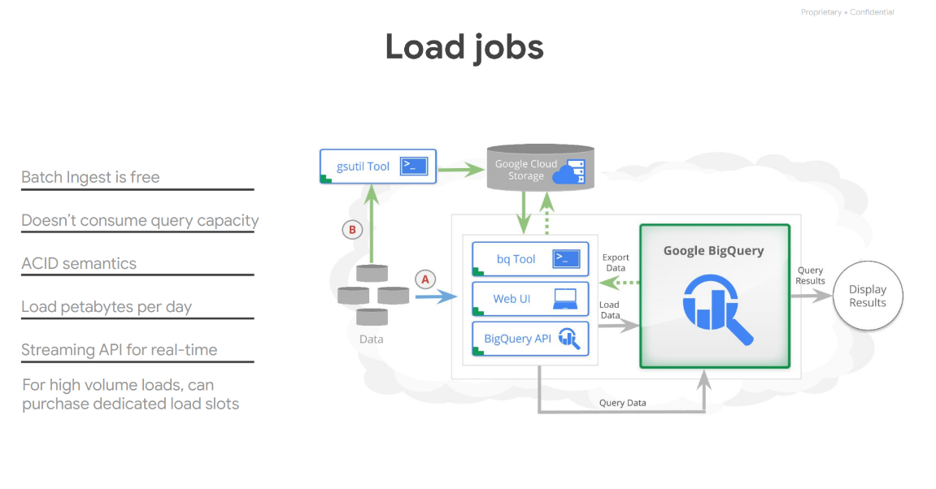
Notes:
19

Slide 20
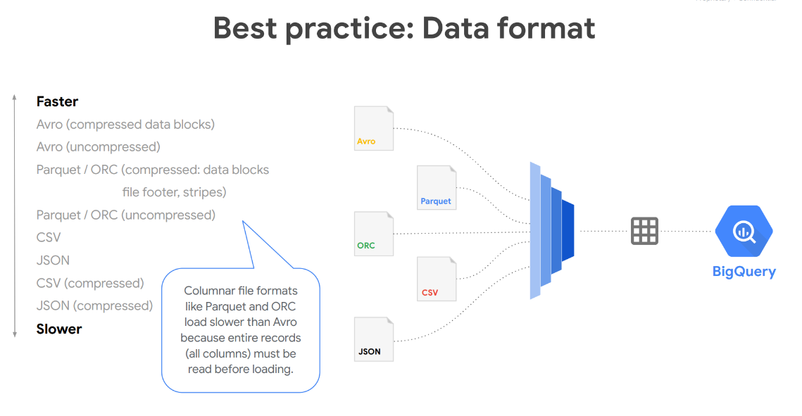
Notes:
20

Slide 21
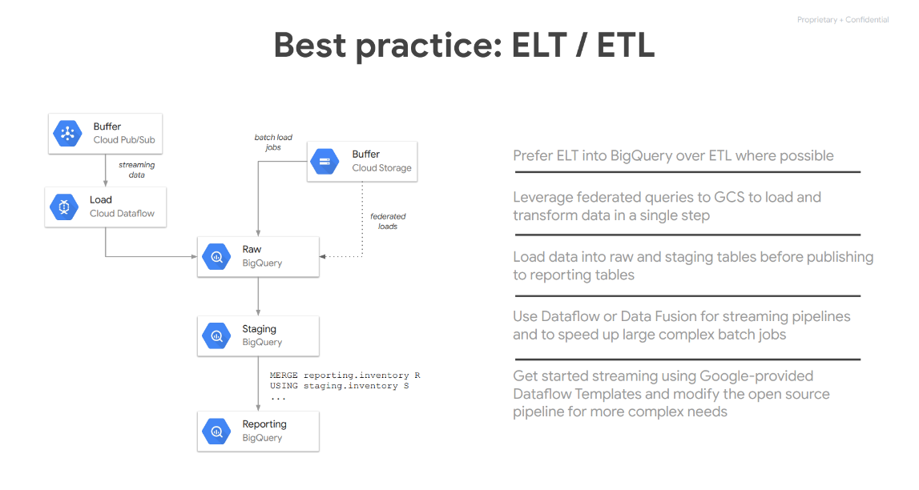
Notes:
21

Slide 22
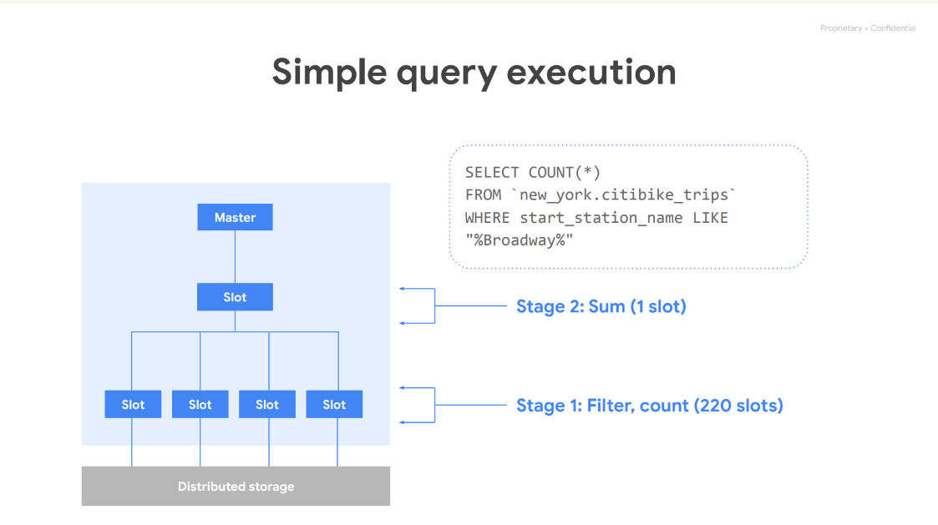
Notes:
22

Slide 23
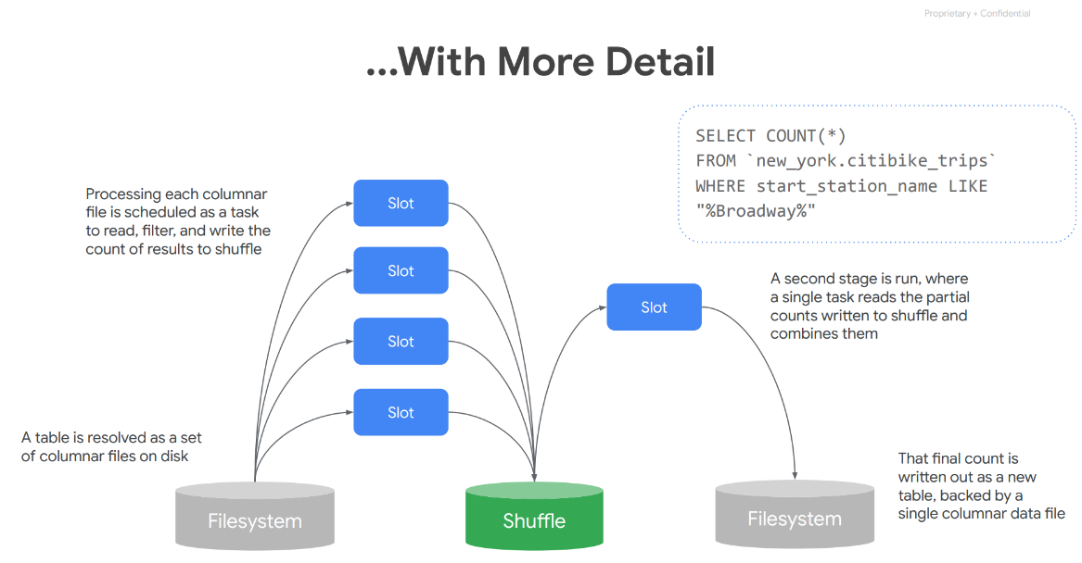
Notes:
23

Slide 24
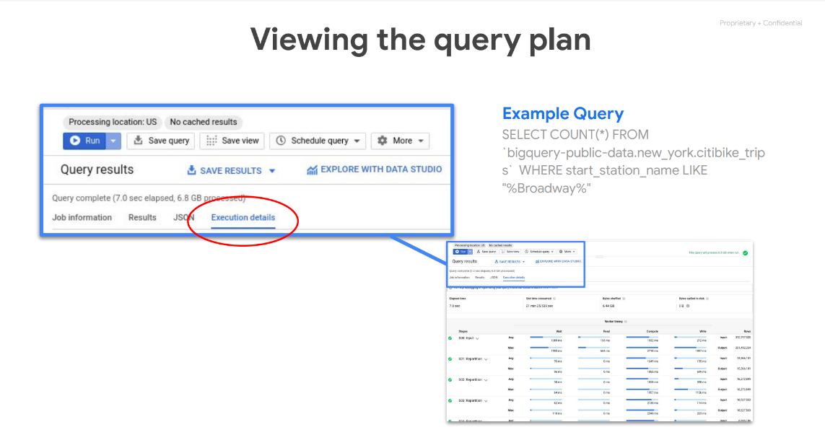
Notes:
24

Slide 25
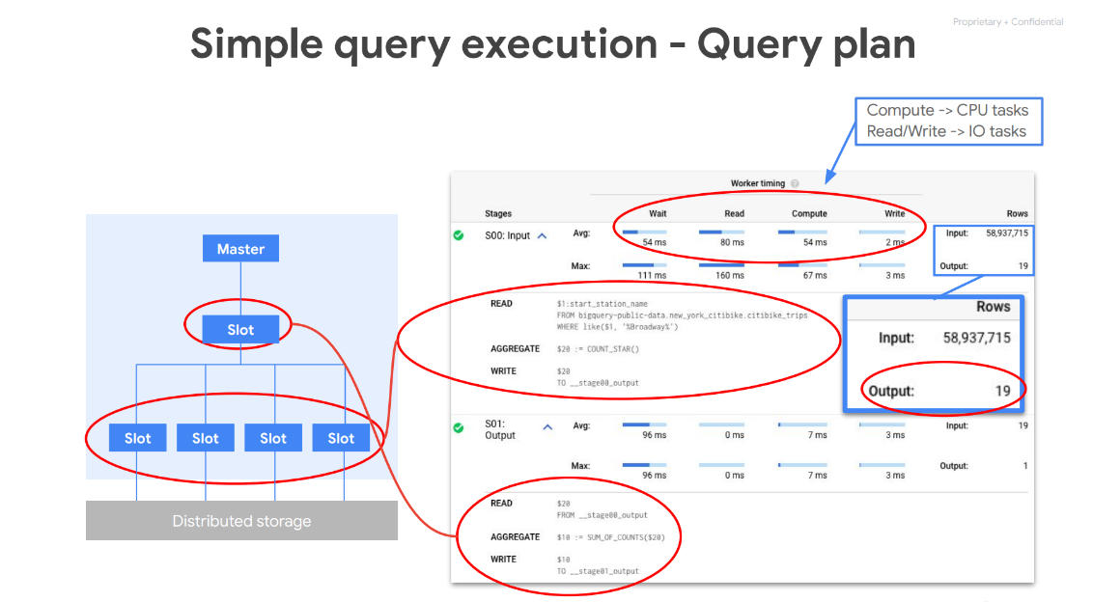
Notes:
25

Slide 26
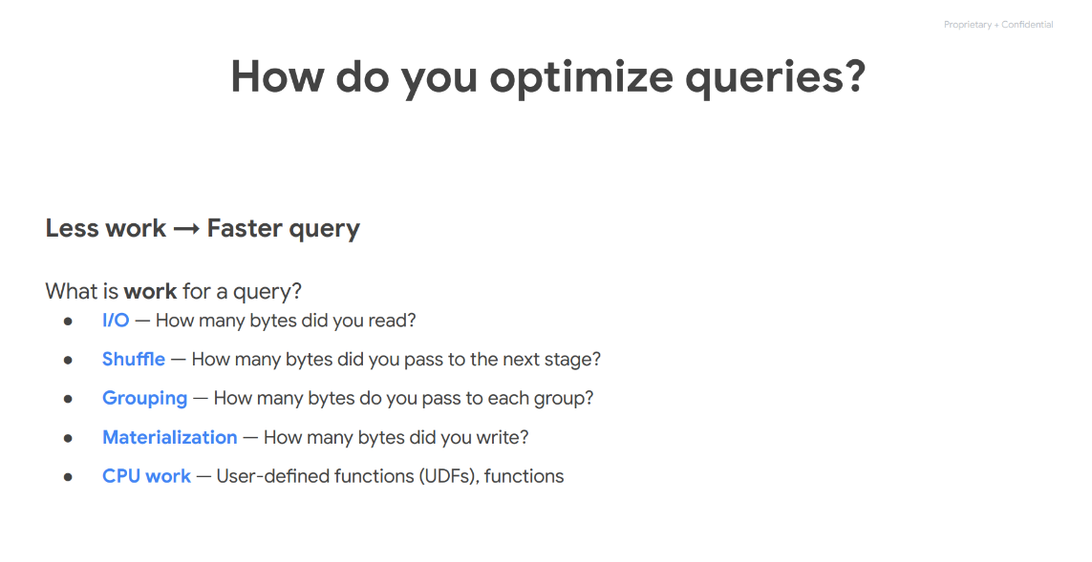
Notes:
26

Slide 27
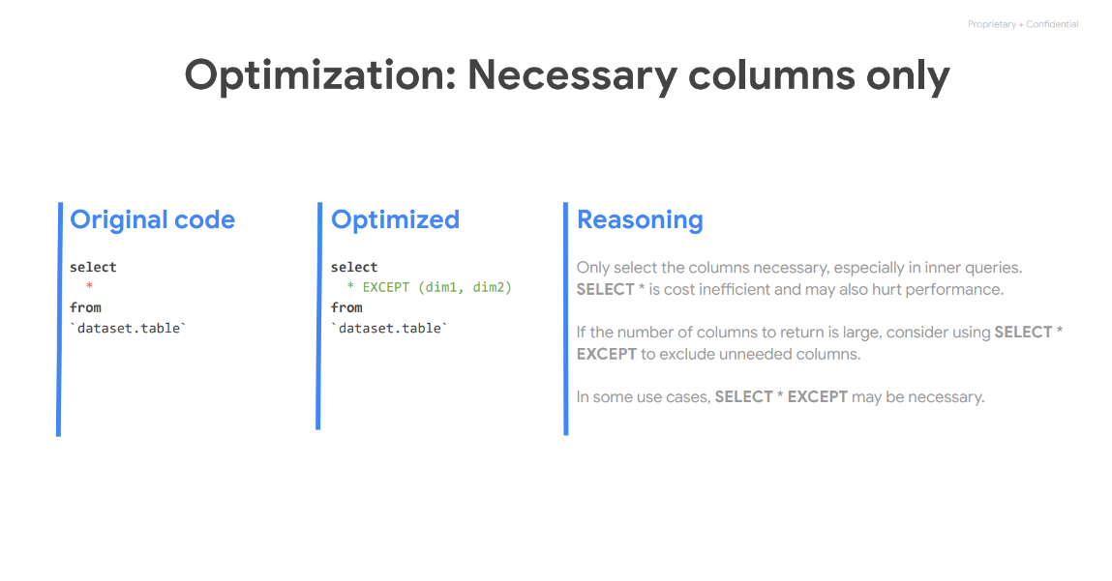
Notes:
27

Slide 28
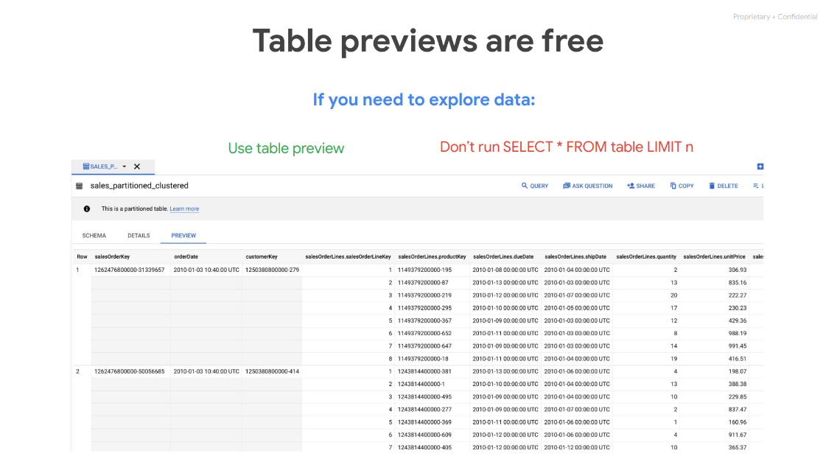
Notes:
28

Slide 29
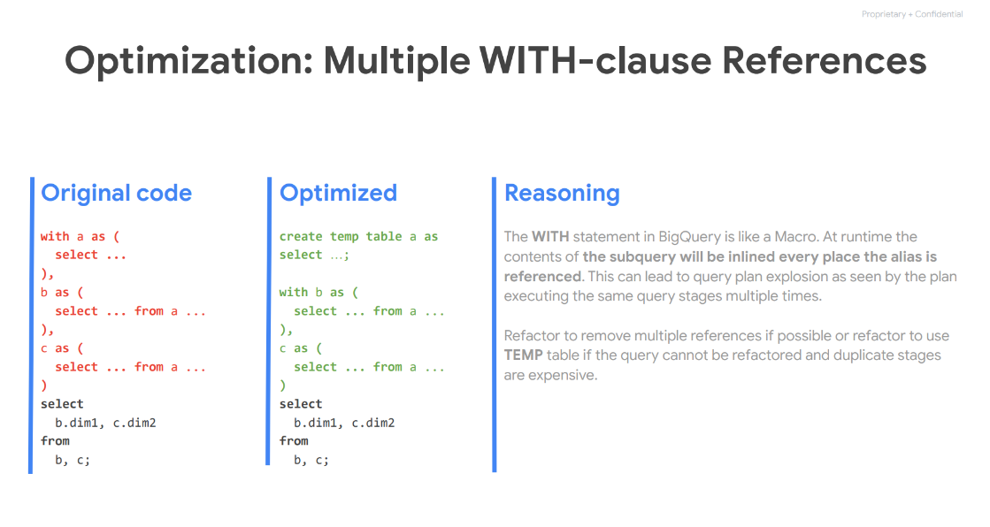
Notes:
29

Slide 30
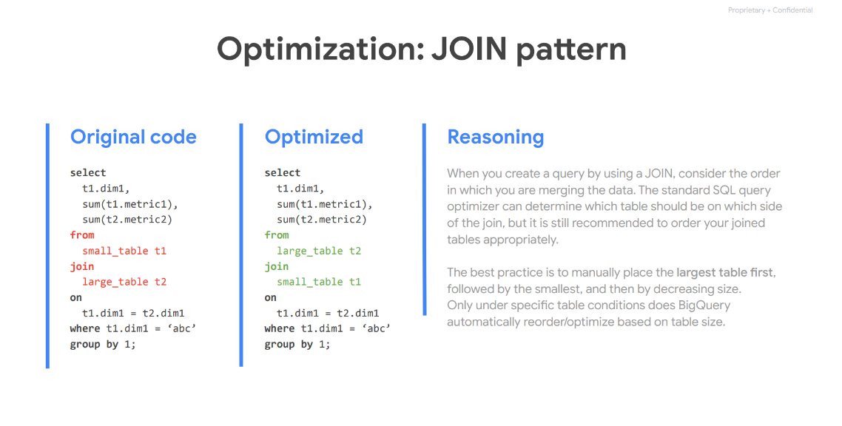
Notes:
30

Slide 31
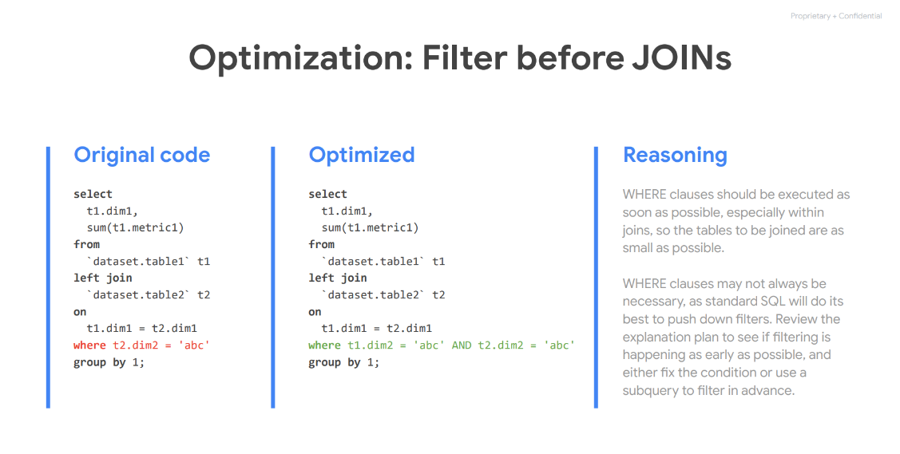
Notes:
31

Slide 32
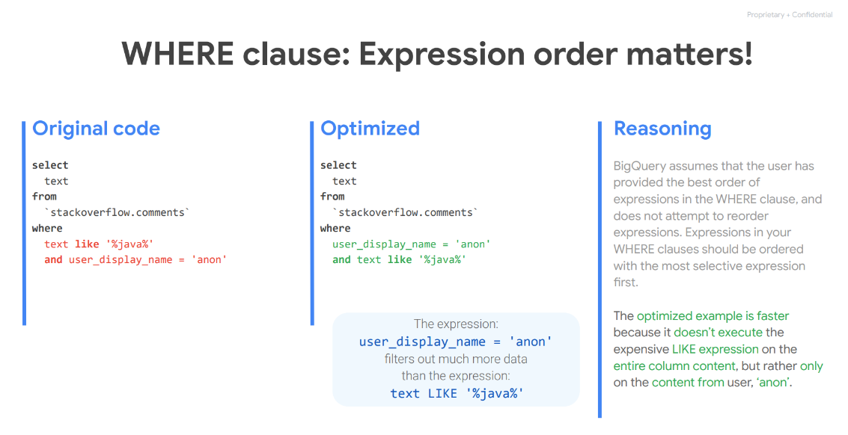
Notes:
32

Slide 33
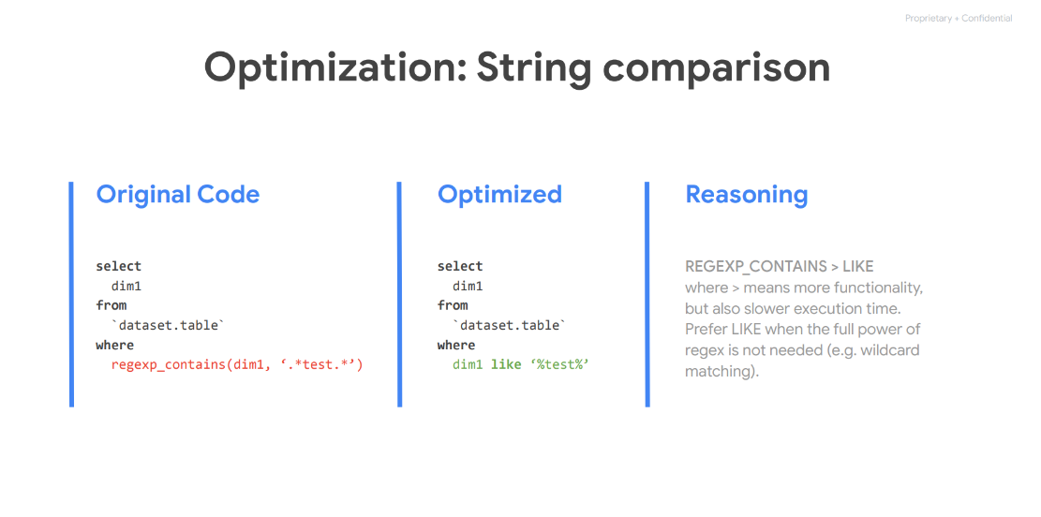
Notes:
33

Slide 34
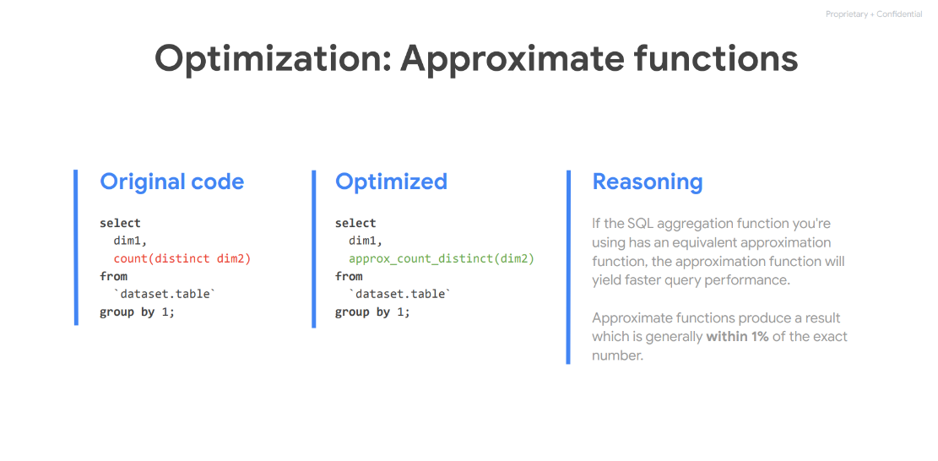
Notes:
34

Slide 35
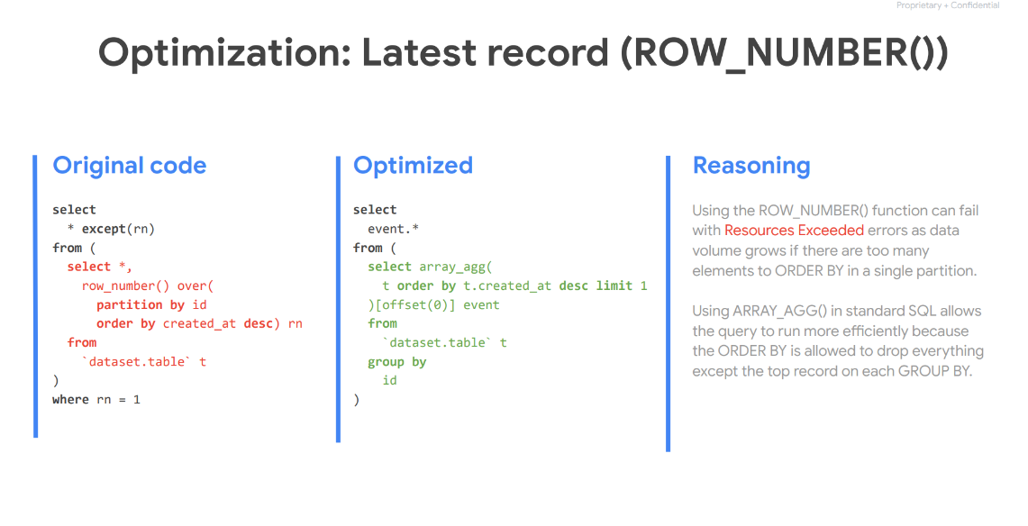
Notes:
35

Slide 36
Hora de practicar !
Notes:
36

Slide 37



“Si puedes imaginarlo podemos hacerlo”
Gracias por tu atención

